Slide 1
Introduction to Electric and Electronics
Chapter 5 –
AC Steady State Analysis

Slide 2
Learning Objectives
Learning Objectives
To understand the ac forcing function
To be able to determine the network response to a sinusoidal signal
To understand the phasor concept and its use in ac steady-state analysis
To learn the concepts of impedance and admittance
To be able to apply all the analysis procedures to ac sinusoidal steady-state circuits

Slide 3

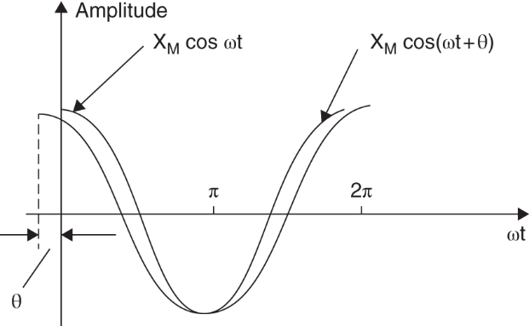
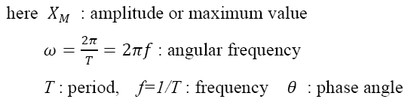
The AC Forcing Function
The AC Forcing Function
Sinusoidal function

Slide 4
Phasors and Complex Number
Phasors and Complex Number
Complex Numbers
A powerful method for representing sinusoids is the phasor.
But in order to understand how they work, we need to cover some complex numbers first.
A complex number z can be represented in rectangular form as:
It can also be written in polar or exponential form as:

Slide 5
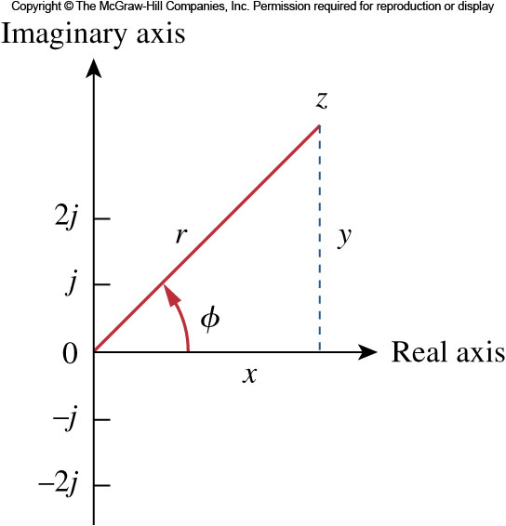
Phasors and Complex Number
Complex Numbers II
The different forms can be interconverted.
Starting with rectangular form, one can go to polar:
Likewise, from polar to rectangular form goes as follows:

Slide 6
Phasors and Complex Number
Complex Numbers III
The following mathematical operations are important
Addition
Subtraction
Multiplication
Division
Reciprocal
Square Root
Complex Conjugate

Slide 7
Phasors and Complex Number
Phasors
The idea of a phasor representation is based on Euler’s identity:
From this we can represent a sinusoid as the real component of a vector in the complex plane.
The length of the vector is the amplitude of the sinusoid.
The vector, V, in polar form, is at an angle φ with respect to the positive real axis.

Slide 8
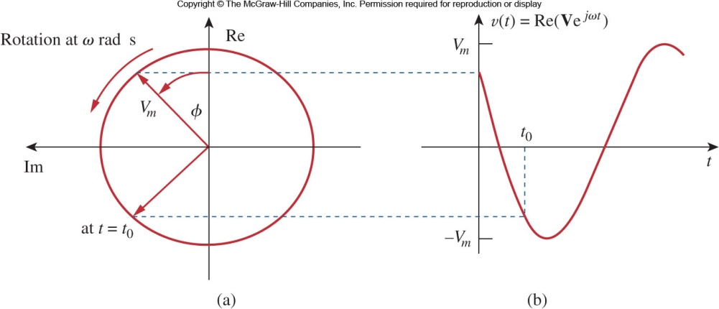
Phasors and Complex Number
Phasors II
Phasors are typically represented at t=0.
As such, the transformation between time domain to phasor domain is:
They can be graphically represented as shown here.

Slide 9
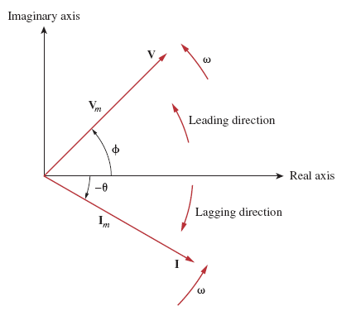
Phasors and Complex Number
Phasor Diagram
A convenient way to compare sinusoids of the same frequency is to use a phasor diagram.
Here the magnitude is represented as the length of the arrow and the phase is represented by the angle.

Slide 10
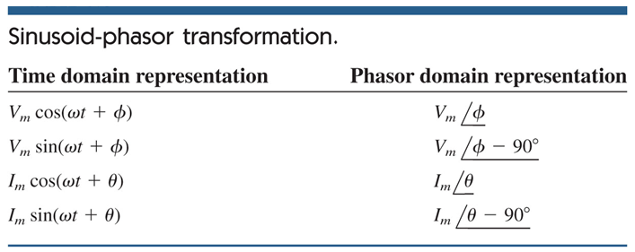
Phasor Relationships for Circuit Elements
Phasor Relationships for Circuit Elements
Here is a handy table for transforming various time domain sinusoids into phasor domain:

Slide 11
Phasor Relationships for Circuit Elements
Sinusoids-Phasor Transformation
Note that the frequency of the phasor is not explicitly shown in the phasor diagram
For this reason phasor domain is also known as frequency domain.
Applying a derivative to a phasor yields:
Applying an integral to a phasor yields:

Slide 12
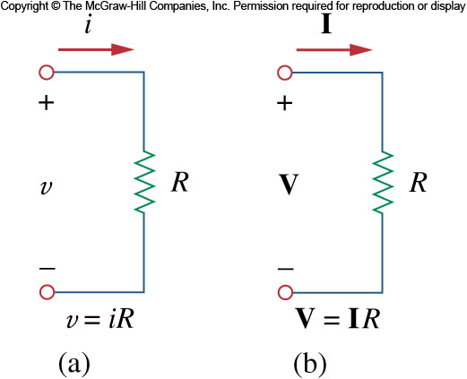
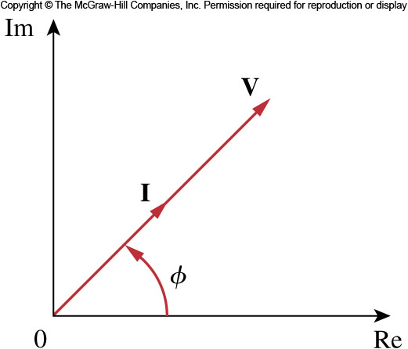
Phasor Relationships for Circuit Elements
Phasor Relationships for Resistors
Each circuit element has a relationship between its current and voltage.
These can be mapped into phasor relationships very simply for resistors capacitors and inductor.
For the resistor, the voltage and current are related via Ohm’s law.
As such, the voltage and current are in phase with each other.

Slide 13
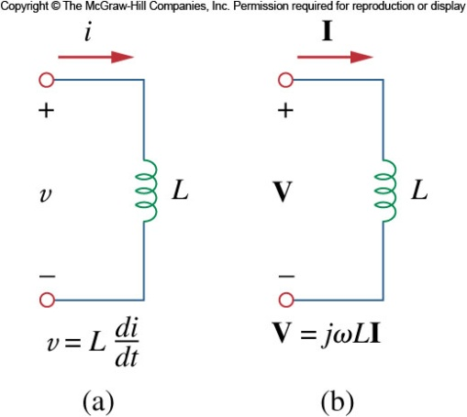
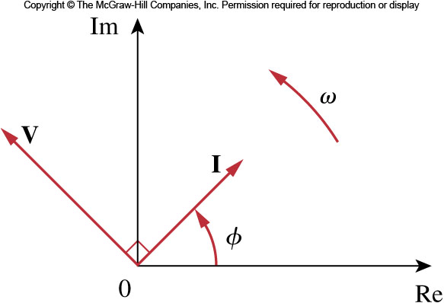
Phasor Relationships for Circuit Elements
Phasor Relationships for Inductors
Inductors on the other hand have a phase shift between the voltage and current.
In this case, the voltage leads the current by 90°.
Or one says the current lags the voltage, which is the standard convention.
This is represented on the phasor diagram by a positive phase angle between the voltage and current.

Slide 14
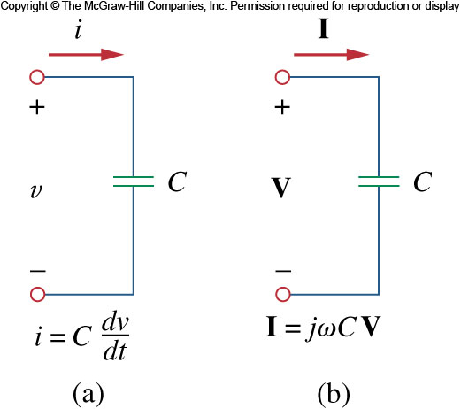

Phasor Relationships for Circuit Elements
Phasor Relationships for Capacitors
Capacitors have the opposite phase relationship as compared to inductors.
In their case, the current leads the voltage.
In a phasor diagram, this corresponds to a negative phase angle between the voltage and current.

Slide 15
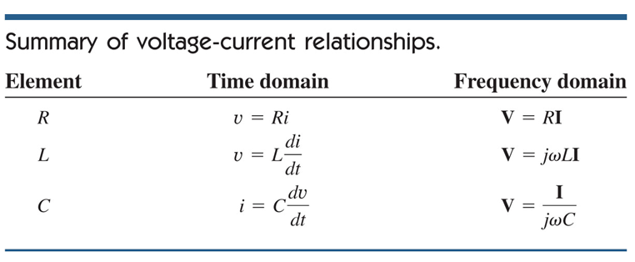
Phasor Relationships for Circuit Elements
Voltage current relationships

Slide 16
Phasor Relationships for Circuit Elements
Example
is applied to a 0.1 H inductor. Find the steady-state current through the inductor.

Slide 17
Impedance and Admittance
Impedance and Admittance
It is possible to expand Ohm’s law to capacitors and inductors.
In time domain, this would be tricky as the ratios of voltage and current and always changing.
But in frequency domain it is straightforward
The impedance of a circuit element is the ratio of the phasor voltage to the phasor current.
Admittance is simply the inverse of impedance.

Slide 18
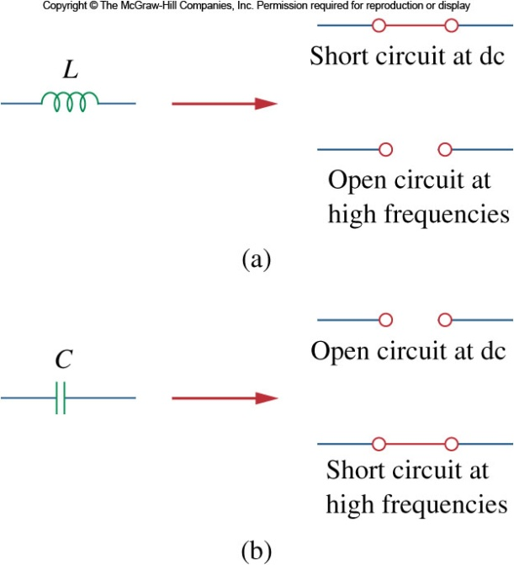
Impedance and Admittance
Impedance and Admittance II
It is important to realize that in frequency domain, the values obtained for impedance are only valid at that frequency.
Changing to a new frequency will require recalculating the values.
The impedance of capacitors and inductors are shown here:

Slide 19
Impedance and Admittance
Impedance and Admittance III
As a complex quantity, the impedance may be expressed in rectangular form.
The separation of the real and imaginary components is useful.
The real part is the resistance.
The imaginary component is called the reactance, X.
When it is positive, we say the impedance is inductive, and capacitive when it is negative.

Slide 20
Impedance and Admittance
Impedance and Admittance IV
Admittance, being the reciprocal of the impedance, is also a complex number.
It is measured in units of Siemens
The real part of the admittance is called the conductance, G
The imaginary part is called the susceptance, B
These are all expressed in Siemens or (mhos)
The impedance and admittance components can be related to each other:

Slide 21
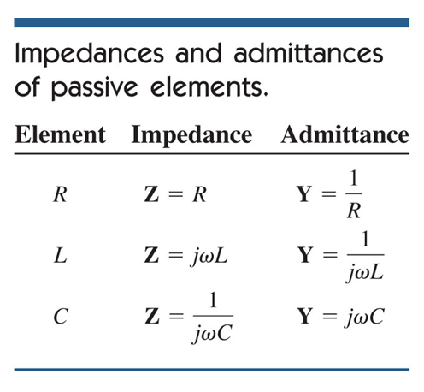
Impedance and Admittance
Impedance and Admittance V

Slide 22
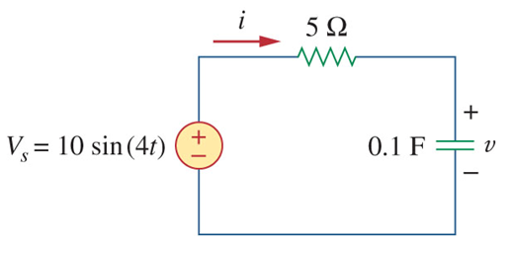
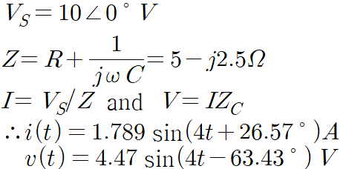
Impedance and Admittance
Example
Find v(t) and i(t)

Slide 23
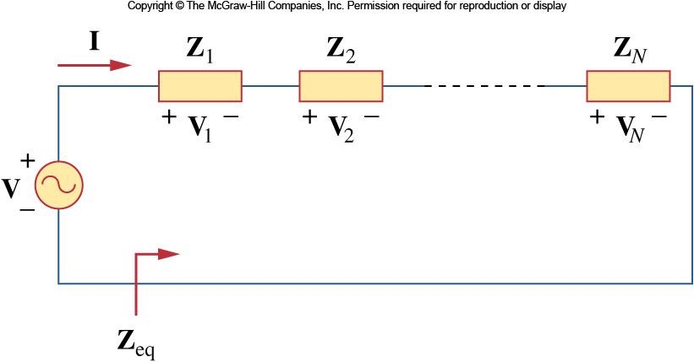
Impedance Combinations
Impedance Combinations
Once in frequency domain, the impedance elements are generalized.
Combinations will follow the rules for resistors:

Slide 24
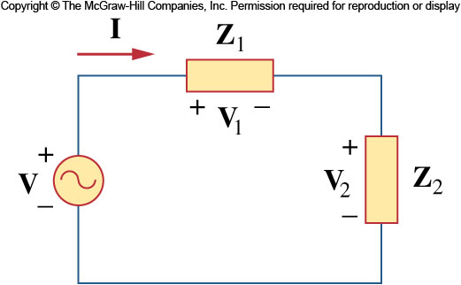
Impedance Combinations
Series Combinations
Series combinations will result in a sum of the impedance elements:
Here then two elements in series can act like a voltage divider

Slide 25
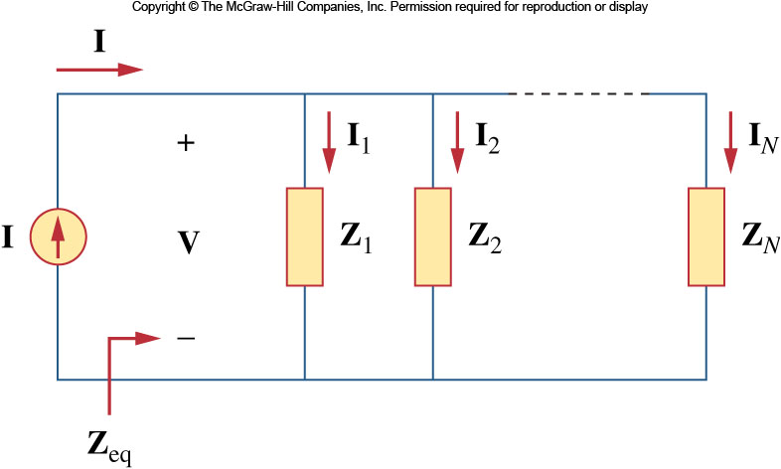
Impedance Combinations
Parallel Combinations
Likewise, elements combined in parallel will combine in the same fashion as resistors in parallel:

Slide 26
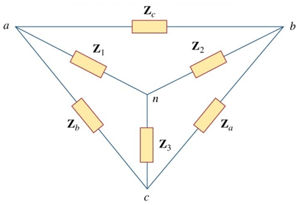
Impedance Combinations
Delta-Wye transformation

Slide 27
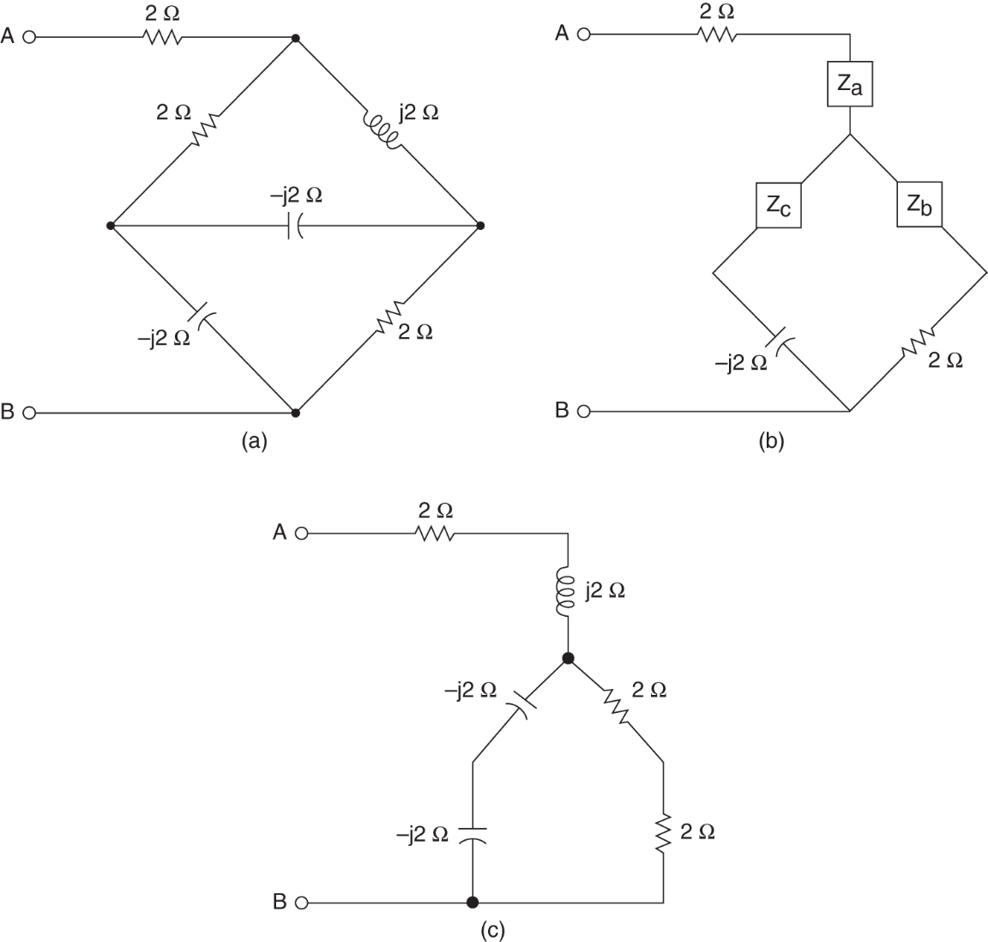
Impedance Combinations
Example 5.5

Slide 28
Kirchhoff’s Law
Kirchhoff’s Laws in Frequency Domain
A powerful aspect of phasors is that Kirchhoff’s laws apply to them as well.
This means that a circuit transformed to frequency domain can be evaluated by the same methodology developed for KVL and KCL.
One consequence is that there will likely be complex values.

Slide 29
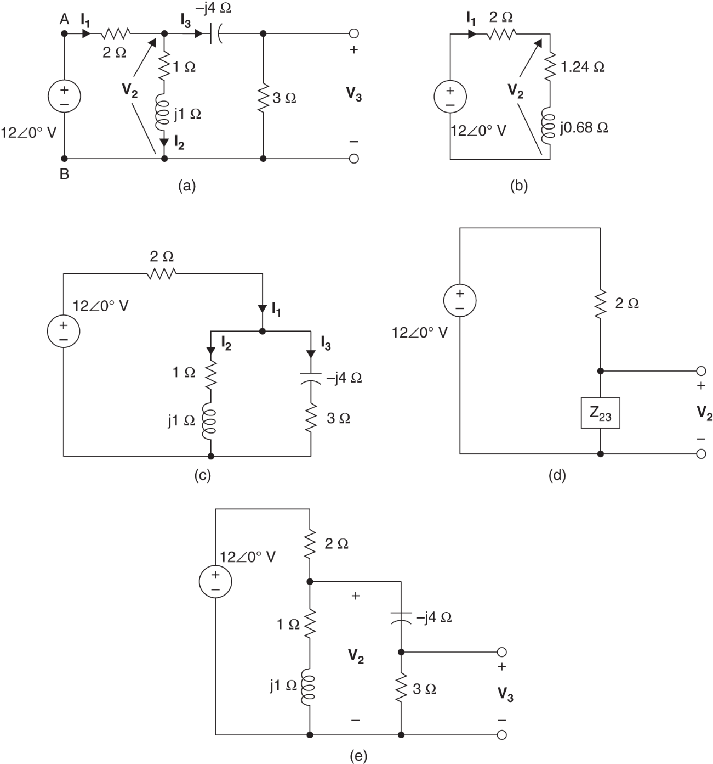
Analysis Techniques

Slide 30
Homework
Homework
Read Text Chapter 6.
Prepare Presentation

